Slide 1
GW Data Project
By Pius Odhiambo

Slide 2
Project Summary
This project is about tracking down the disbursement of SBA loans from 2012 – 2020 within the United States of America.

Slide 3
Front End Technologies
Power BI Desktop | Services
HTML 5
CSS

Slide 4
Back End Technologies
SQL Server
Python (Pandas Library, Shutil Library, OS Library)
SQL Server Integration Services
SQL Server Management Studio
Google Cloud SQL Instance
Github

Slide 5
Process
Create a google account
Provision Cloud SQL Instance
Create Database
Create Connection btw the Database and SSMS
Load Data into the Database using SISS
Connect your Data to Power BI

Slide 6
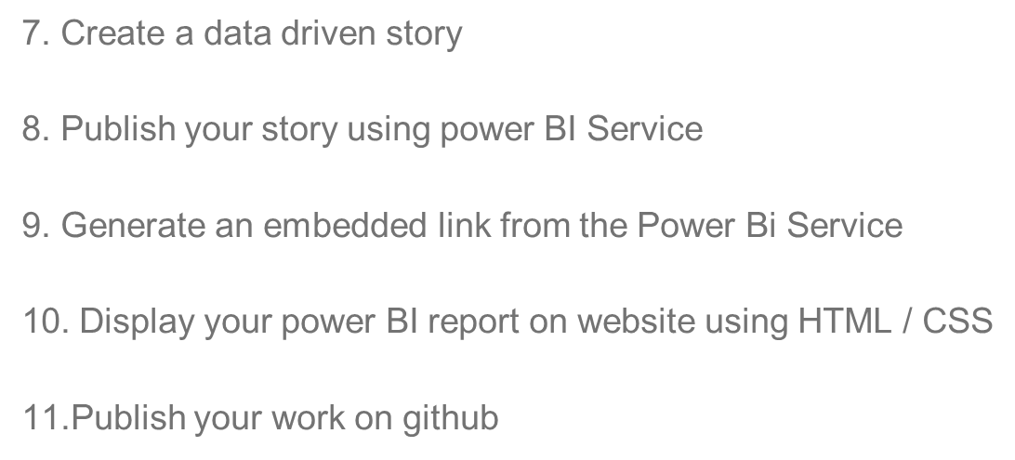
STEPS continues
STEPS

Slide 7
Q & A
Any Questions ?

